Slide 1

Revolution Model
Amirhooshang Navaei

Slide 2
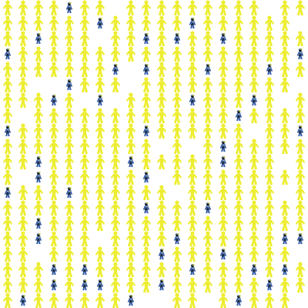
Turtles and actions
Cops
Kill
Arrest
Agents (people)
Rebel (act)
Emigrate

Slide 3
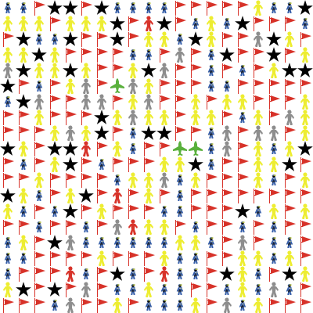







States of Agents:
Active: red person
Quiet: yellow person
Doubtful: grey person
Jailed: red flag
Migrated: green airplane
Killed: black star
Police: blue person

Slide 4
Global Variables (interface):
Type | Name | Measurement | Details
Slider | Initial Agents Vision | 2 - 15 neighbors | Determines how far each agent can see initially. influencing the behavior of an agent.
 | Shock Rate | 0-5 | Represents the frequency of unexpected or unreasonable actions by the government.
 | Cops Density | 0-20% | Determines the proportion of patches occupied by law enforcement officers (cops) in the simulation. Higher cop density leads to increased control over the population.
 | Quality of Life Index (the World Bank): | 0-79 | Represents various indicators of well-being (access to healthcare, education, and basic services). A higher level of index suggests better living conditions for the population, which contributes to higher levels of satisfaction and stability within the society. Changes in the index may influence agent perceptions of the government's legitimacy and their willingness to engage in protest or rebellion.
 | Corruption Perception Index (Transparency International) | 0-90 | Reflects the perceived levels of corruption within a country. A lower corruption perception index indicates higher levels of perceived corruption, which can erode trust in government institutions and foster discontent among the population. Changes in the corruption perception index may affect agent attitudes towards authority, potentially fueling anti-government sentiment and activism.
Switch | Internet Disconnection | On/Off | Toggles whether the internet is disconnected in the simulation. If it is “On”, the Agents Vision decreases till 2 in case if the protestors ratio is high and close to the revolution ratio. It simulates scenarios where agents lose access to external information sources (social media or news platforms) in real life. Internet disconnection can affect the spread of information, the formation of opinions, and the coordination of collective actions among agents.

Slide 5
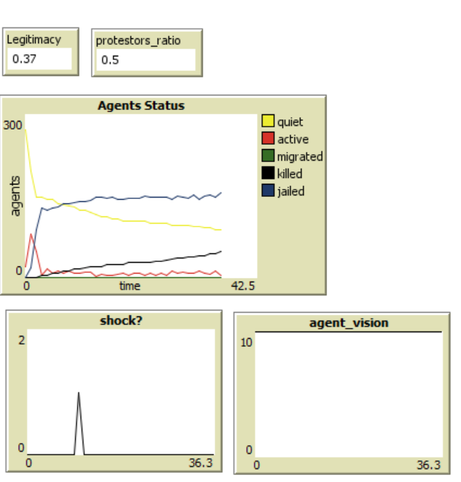
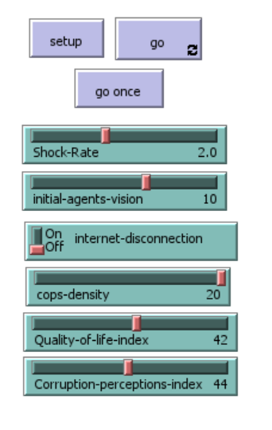

Slide 6

Global variables (code):
Name | Details
Base Legitimacy | a weighted average of the Quality-of-Life Index and the Corruption Perception Index.
Legitimacy | an updated version of base legitimacy
Protestors Ratio | number of active and jailed agents to the alive population
World Status | Revolution (protestors ratio > 0.5) or not
Agent vision | Equal to initial agents' vision if the internet is connected Equal to 2 if the internet is disconnected
Revolution threshold | the necessary ratio of protestors for a revolution

Slide 7
Variables:
Cops Variables:
Cops’ vision: 1.5 * agents’ visions
Violence level: function of protestors ratio and government legitimacy
Agents’ Variables:
Rage
Risk aversion
Status
Jailed time
Neighbor Killed, …

Slide 8
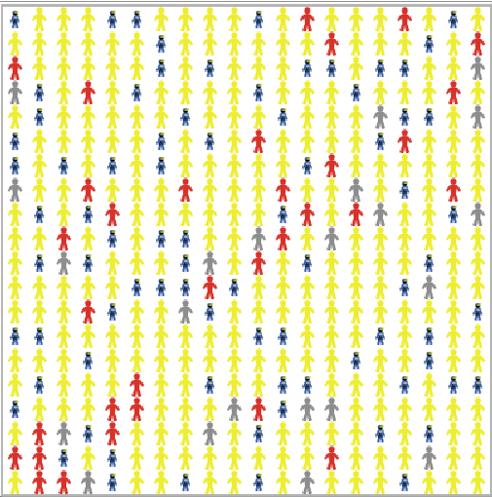
Setup Process:
Initializing global values:
Legitimacy, shock rate, agents' vision, revolution threshold
Setting the general features of the world:
Size, patch size, background color
Computing number of agents and cops
Creating Agents:
Rage, Risk aversion, condition, initial status
Creating Cops:
Cops’ visions, Violence Level

Slide 9
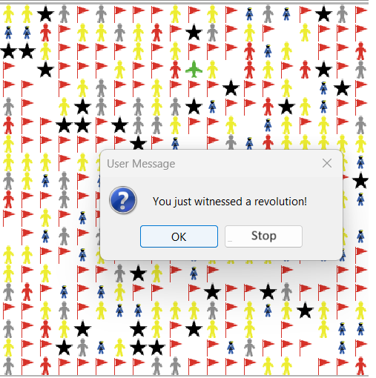
“go” Process:
Evaluating the “stop” condition:
If the necessary condition for revolution is satisfied, stop the program and print a message.
Function 1: “Update Global Variables”
Function 2: “Cops’ act”
Function 3: “Update Agents’ Status”
Function 4: “Agents’ Act”

Slide 10
“Update Global Variables”
Recompute the legitimacy of the government as a function of killed agents.
Updating the “Protestors Ratio”:
number of active and jailed agents, divided by the total number of agents.
Updating the “world status”:
if “Protestors Ratio” is larger than “Revolution Threshold”, the variable changes to 1.
“Internet Disconnection”:
If the button is “on”, the “Protestors Ratio” is approaching the threshold, government disconnects internet, and decreases the agents’ vision to 2.

Slide 11

“Cops’ Act”
Updating “Violence Level”:
Government legitimacy, Protestors Ratio
Checking the number “Active” agents in its vision and selecting one of them randomly.
Depending on the “Violence Level” decides:
Killing the Agent
Arresting the agent; Giving her a jailed time (~Protestors Ratio)

Slide 12
“Update agents’ Status”
Updating “Rage”, “Risk Aversion” and “condition”:
If the agent is alive and not migrated.
Number of “killed”, “jailed”, “active”, and “migrated” agents and the number of “cops”, and “shocks” affect “rage” and “risk aversion”.
If the “agent” is “jailed”, the “jailed time” decreases by 1:
if “jail time” is not positive, the status of the agent changes to one of free statuses.

Slide 13
“Agents’ Act”
Based on the values of “condition”, “risk aversion”, several global variables, the agent decides whether to act or not:
Rebel
Silence
Migrate

Slide 14
Potential Research Questions
How do each of these variables affect the likelihood of the revolution?
Shock Rate: Increase
Agents’ Vision: Increase
Internet disconnection: Decrease
Cops Density: Decrease
Government Legitimacy: Decrease

Slide 15
References
Modeling civil violence: An agent-based computational approach. (2002, March 25). Modeling civil violence: An agent-based computational approach.
Barakat, Z.; Fakih, A. Determinants of the Arab Spring Protests in Tunisia, Egypt, and Libya: What Have We Learned? Soc. Sci. 2021, 10, 282.
Rebellion Model; Netlogo Library, NetLogo Models Library: Rebellion (northwestern.edu)
Corruption Perception Index, Transparency Internationl, 2023 Corruption Perceptions Index: Explore the… - Transparency.org
Quality-of-Life Index, worlddata, Quality of life in country comparison (worlddata.info)

